Slide 1

AVIATION CONSULTING
Mohamad Doughan
Data Analytics Bootcamp March 2020

Slide 2
Understanding the Situation
Airline Industry – Overview
The airline industry is a capital intensive sector and is often considered to have one of the highest Debt/Equity (D/E) ratio
As part of their operations, airlines incur high costs from:
Purchase of planes
Outfit of planes
Fuel
Air hangars
Repairs
Pilots, Flight attendants, and Baggage handlers
The average D/E ratio of major airlines companies is 115 example: for every $1 of shareholder equity, the company is liable for $115
The airline industry is constantly under pressure to generate income to continuously pay off its debt
With the Covid-19 Pandemic, air travel has been one of the hardest-hit industries, with airlines in jeopardy of going bankrupt
Notes:
A brief overview of the Airline Industry, just to put things into context

Slide 3

Objective
The objective of this project is to create a supervised machine learning model that can predict passenger churn rate and accordingly identify major features that affect overall passenger experience In turn, this allows airlines to target customer needs and potentially increase market share (revenues) and mitigate market challenges

Slide 4


Project Approach
1
3
2
Problem Definition
Framework
Key Results

Slide 5

Problem Definition
The dataset used in this project is retrieved from Kaggle, consisting of approx. 26,000 entries and 25 columns
It is based on a US airline passenger survey aimed at understanding various factors affecting attrition rates
Features
Numerical Variables
Nominal Categorical Variables
Ordinal Categorical Variables
Age
Gender
In-flight Wi-fi
Online Boarding
Flight Distance
Customer Type
Time Convenience
Seat Comfort
Departure Delay
Travel Type
Online Booking
In-flight Entertainment
Arrival Delay
Class Type
Gate Location
On-board Service
Food & Drink
Leg Room Service
Check-in Service
Baggage Handling
Cleanliness
In-flight Service
All the above features will be considered for Customer Churn Rate predictions
Notes:
Features of this dataset are divided into 3 categories:
Numerical Variables, Nominal Categorical Variables, and Ordinal Categorical Variables
Ordinal Categorical Variables: I have a grading scale from 0-5, 0 being worst and 5 being best

Slide 6
Tools & References
Tools
References
Python
Pandas
International Air Transport Association IATA
Numpy
Kaggle
Matplotlib
Stack Overflow
Seaborn
Scipy
Medium
Sklearn
Towards Data Science
Statsmodel
Machine Learning Mastery
Kmodes
Python Library’s Documentation
Yellowbrick
Xgboost
Github
Pycaret
Slidesgo
Spyder
Trello

Slide 7
Framework
1
2
3
4
5
Data Acquisition
Data Wrangling and Cleaning
Data Exploration & Analysis
Feature Engineering
Machine Learning Modeling & Evaluation

Slide 8
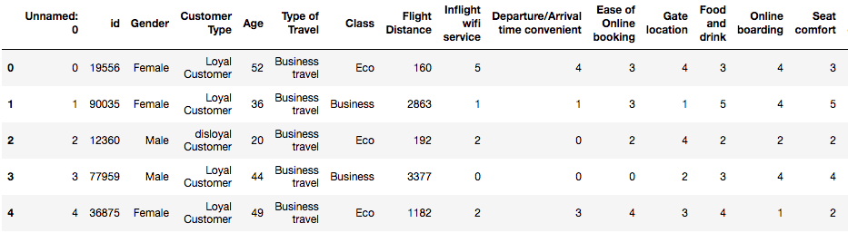
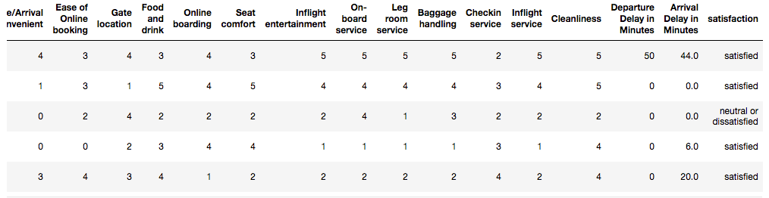
Framework
1
Data Acquisition
Kaggle: https://www.kaggle.com/teejmahal20/airline-passenger-satisfaction
File Type: CSV file
Notes:
A screenshot of the top 5 rows of my raw dataset

Slide 9
Framework
2
Data Wrangling and Cleaning
Data Type Correction
Renaming Columns
Identifying Null Values
Replacing
Dropping
Identifying Duplicates
Encoding Nominal Categorical Data
Identifying Incorrect values
Checking for Low Variance Columns
Dropping Uninformative Columns
Notes:
Step 2 – Data Wrangling and Cleaning

Slide 10
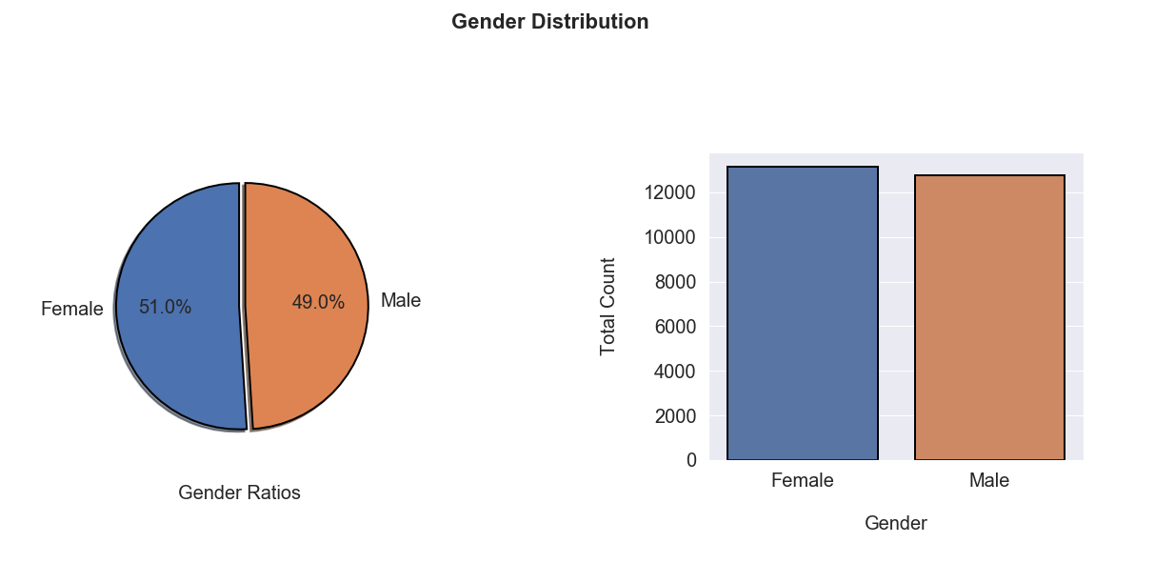
Framework
3
Data Exploration & Analysis
Distribution Plots for the Nominal Categorical Features
Notes:
Step 3 – Data Exploration and Analysis
Started of by exploring the Nominal Categorical Features and outputting their distribution plots and values proportions
Equal split in Gender between Male and Female

Slide 11
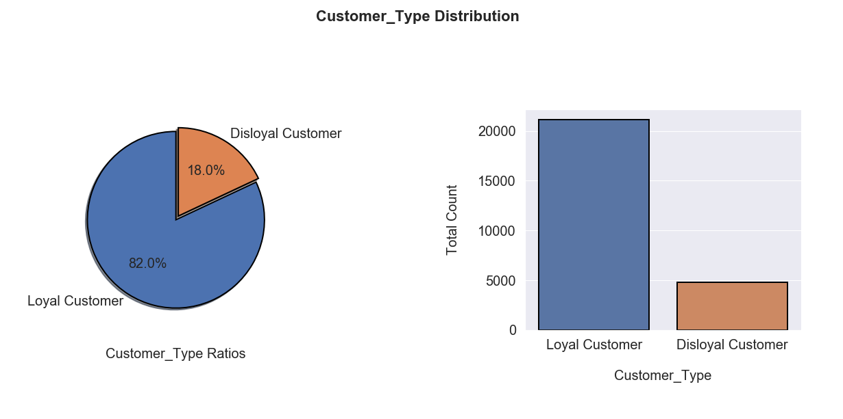
Framework
3
Data Exploration & Analysis
Distribution Plots for the Nominal Categorical Features
Notes:
For the Customer Type Distribution:
It is approximately an 80-20 split, in favor of the Loyal Customers (i.e. passengers enrolled in Loyalty Programs)

Slide 12
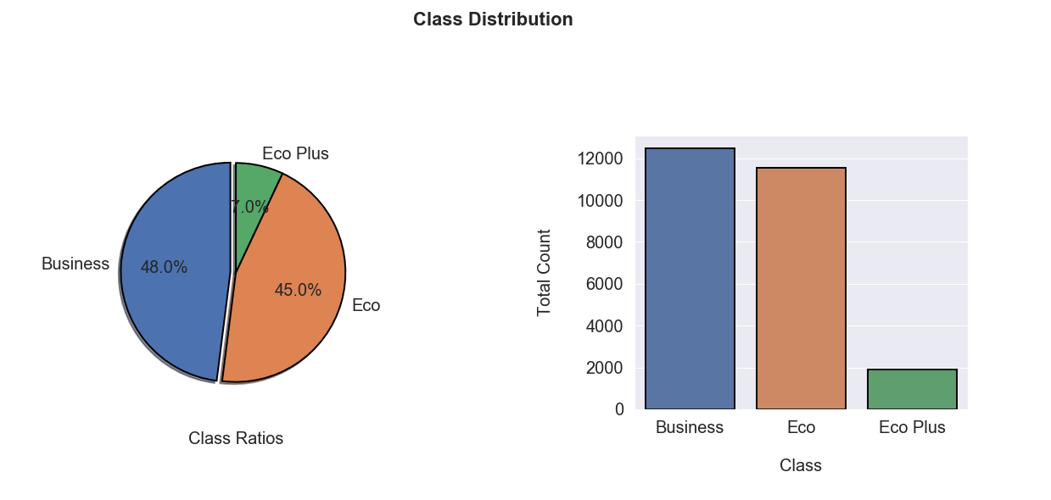
Framework
3
Data Exploration & Analysis
Distribution Plots for the Nominal Categorical Features
Notes:
For the Travel Class Distribution :
It is an equal majority split between Business Class and Economy Class with a small percentage going for Economy Plus

Slide 13
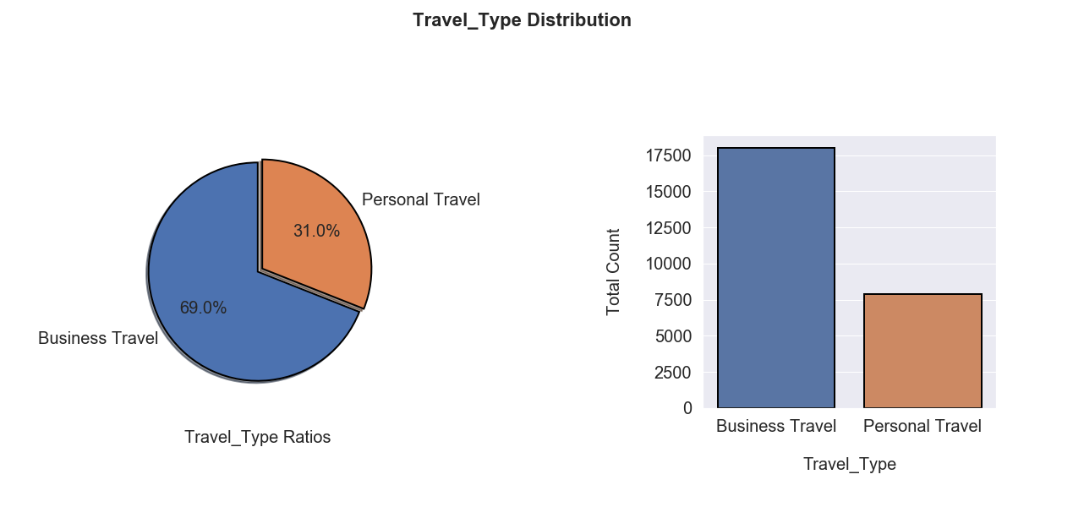
Framework
3
Data Exploration & Analysis
Distribution Plots for the Nominal Categorical Features
Notes:
For Travel Type Distribution:
It is a clear 70-30 split in favor of Business Travel over Personal (i.e. Leisure Travel)

Slide 14
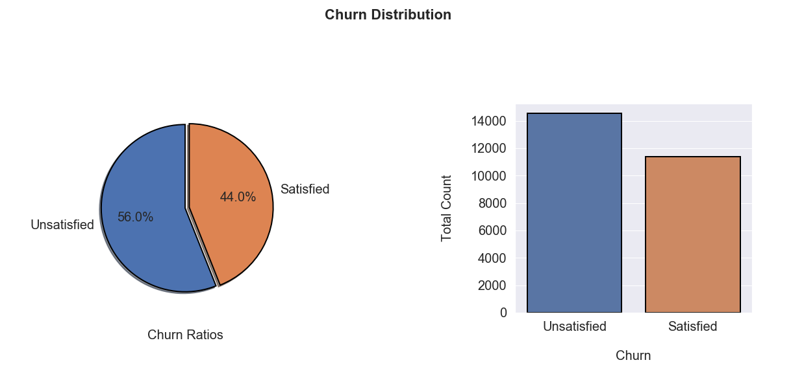
Framework
3
Data Exploration & Analysis
Distribution Plots for the Nominal Categorical Features
Notes:
For the Target Variable, Churn Rate, we can safely assume that we have a balance split, with a slight tip to the Unsatisfied part

Slide 15
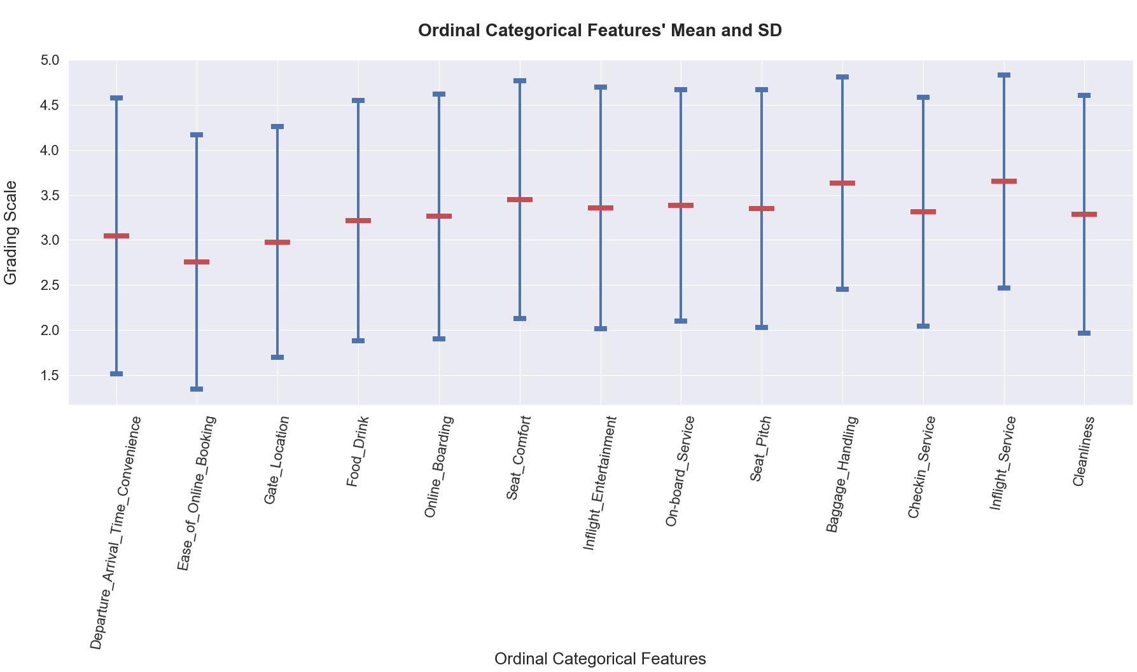
Framework
3
Data Exploration & Analysis
Analyzing the Centrality and Variability of the Ordinal Categorical Features
Notes:
Moving to the Ordinal Categorical Variables, I analyzed the features Centrality and Variability to see how their grade points vary between each other

Slide 16
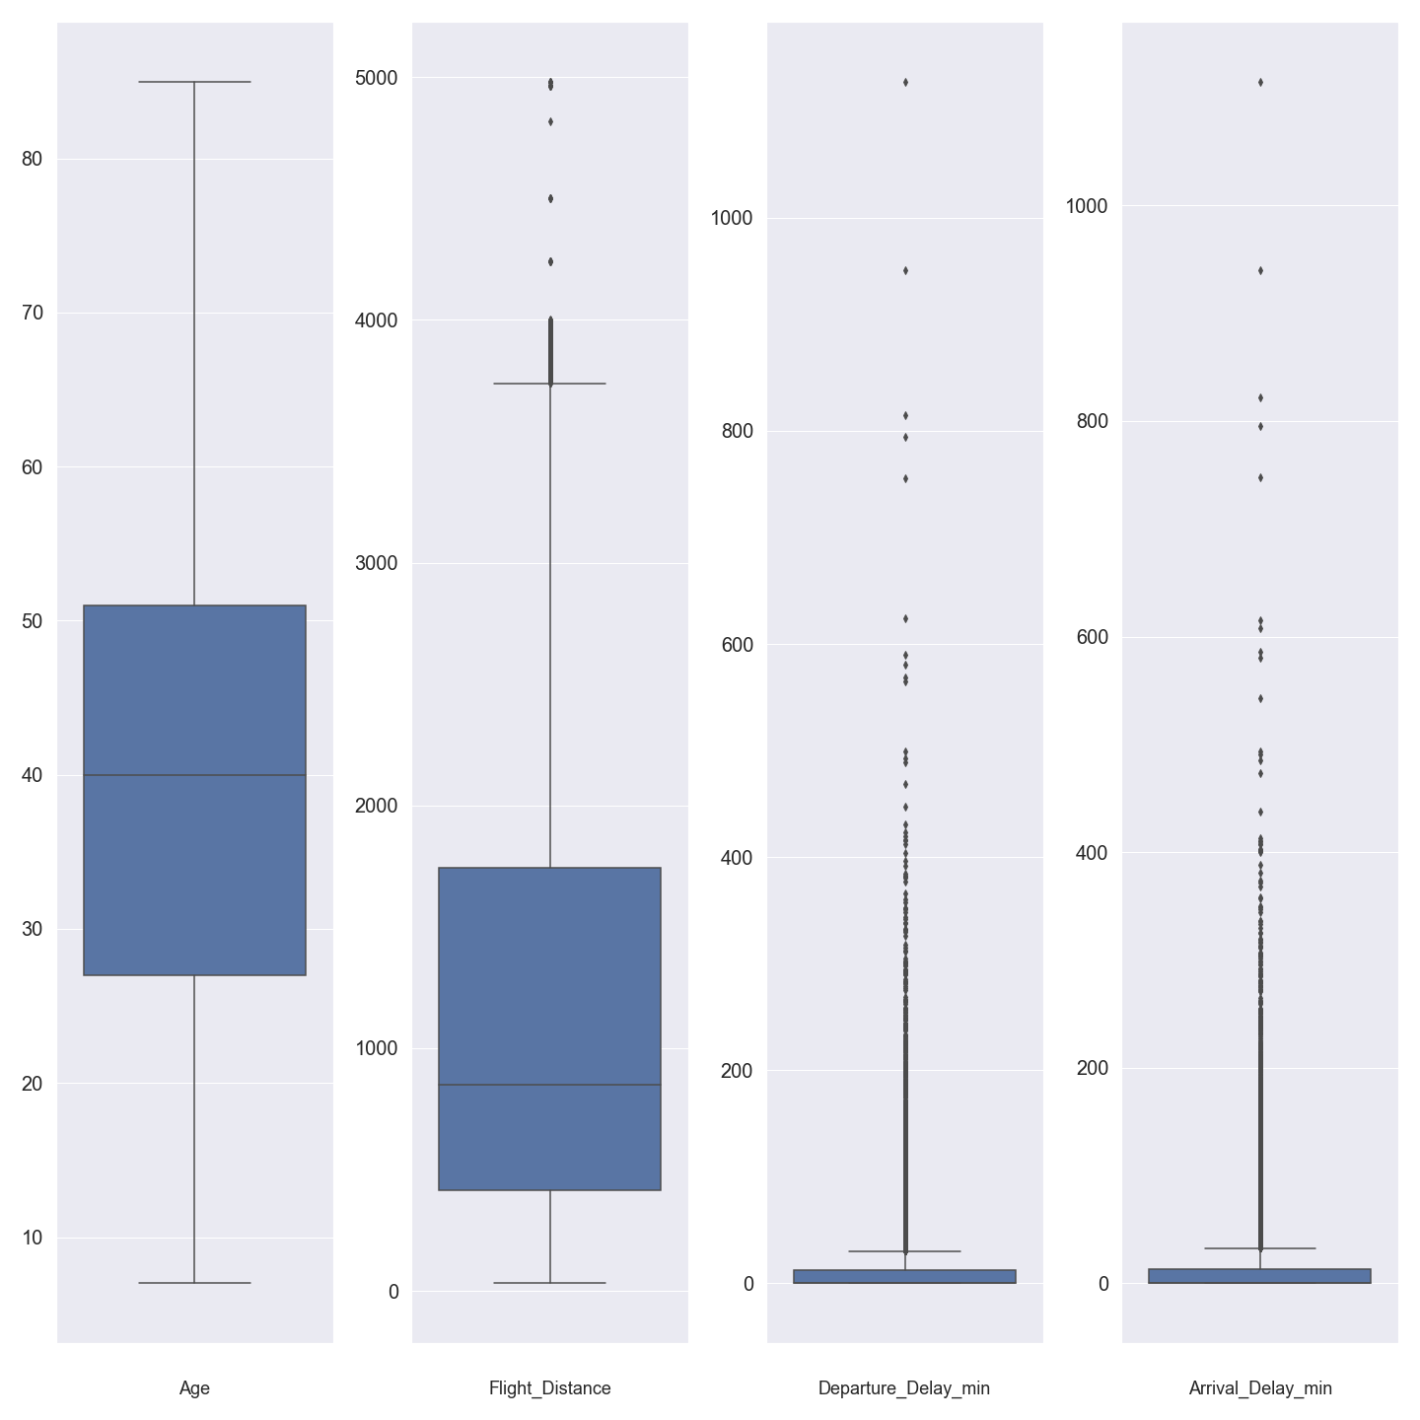
Framework
3
Data Exploration & Analysis
Analyzing the Centrality and Variability of the Numerical Features
Detecting outliers in the following features: Age, Flight Distance, Departure Delay, and Arrival Delay
Box Plot with the inter-quartile range shaded in dark blue and whiskers depicting upper and lower bound of outliers for the dataset

Slide 17
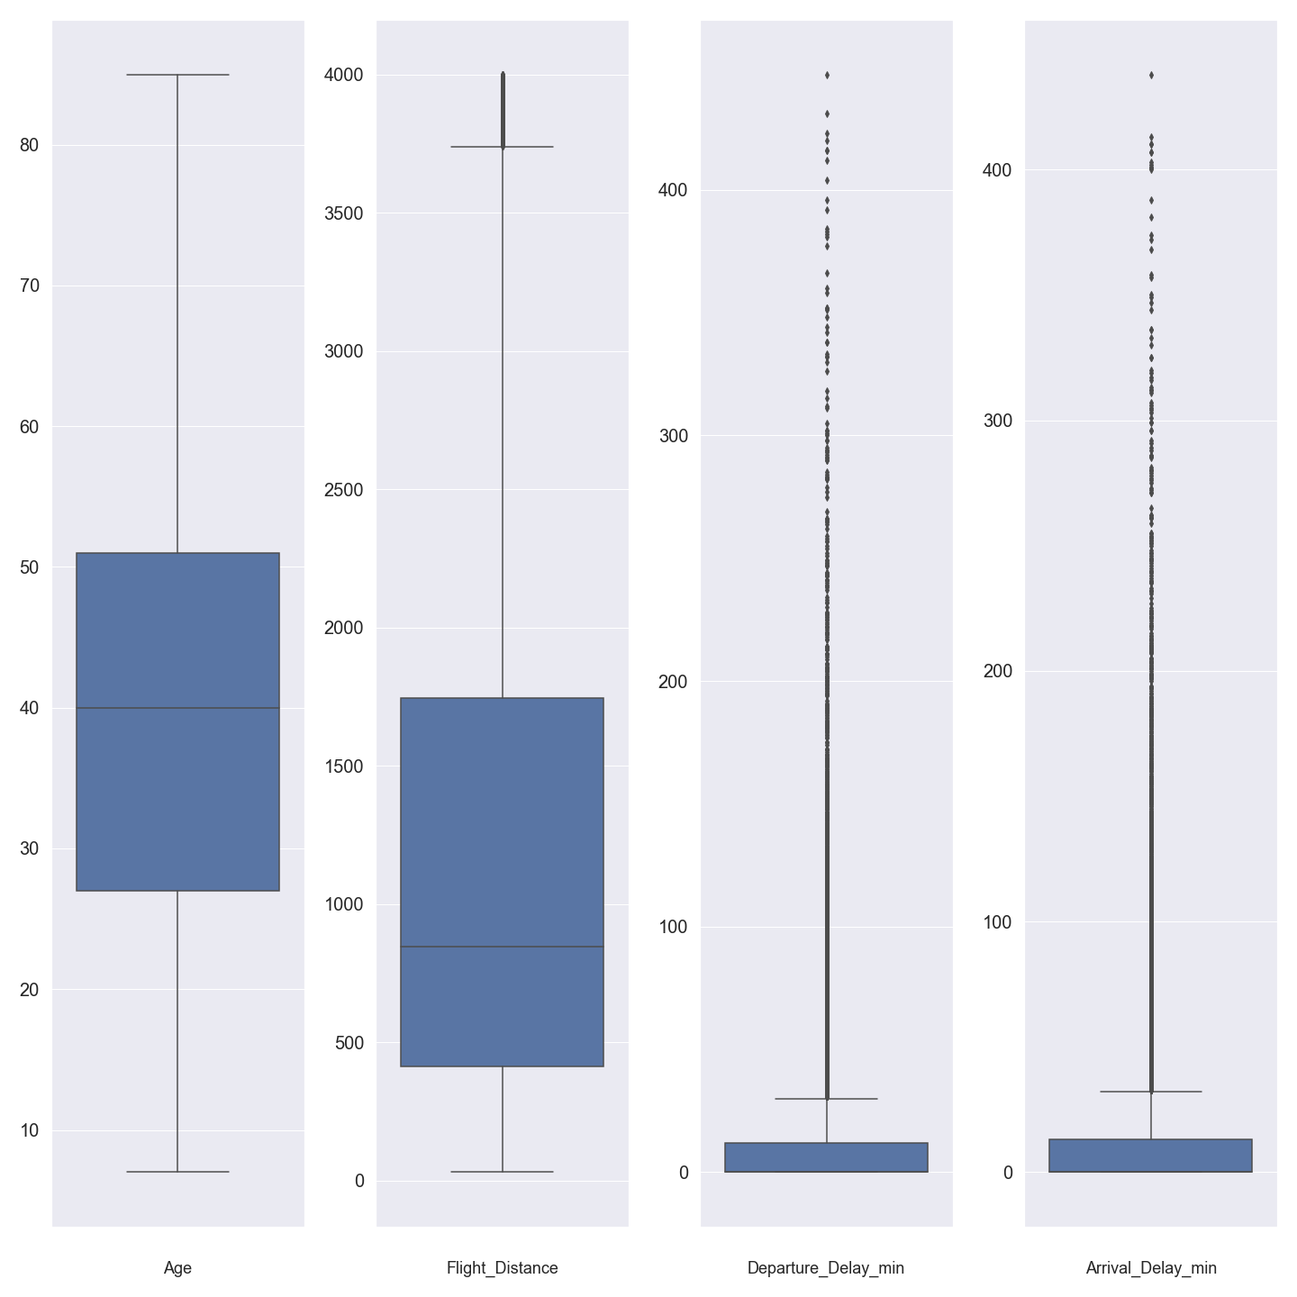
Framework
3
Data Exploration & Analysis
Analyzing the Centrality and Variability of the Numerical Features, cont’d
Updated Box-Plot after dropping extreme and improbable values on a feature-by-feature base
Lower Dispersion of outliers -.> Lower Variance

Slide 18
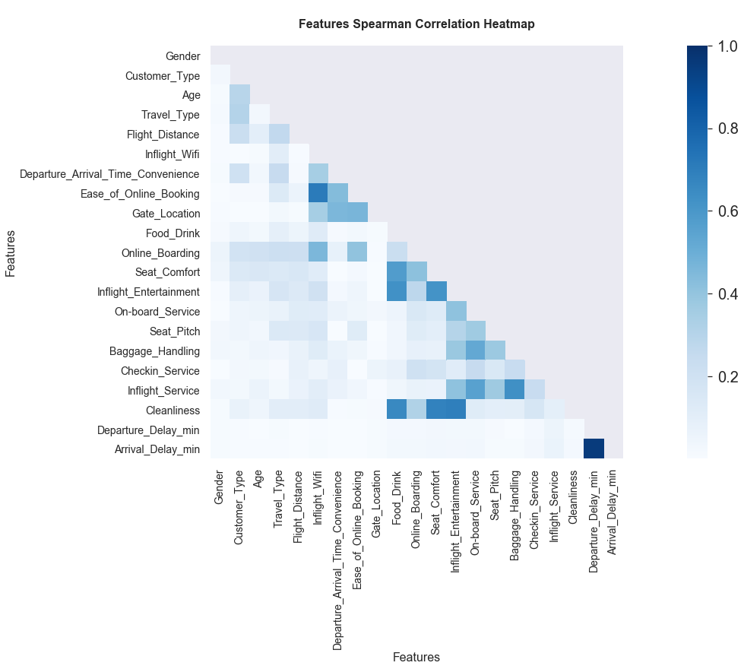
Framework
3
Data Exploration & Analysis
Correlation Heatmap between all features, excluding the target variable, Churn Rate
A Spearman Correlation was used since the majority of my features are ordinal categorical and didn’t show a Guassian Distribution (Left-tail skewed)
Notes:
Minding that math behind Spearman is Pearson based, however the former uses ranked values rather than real values

Slide 19
Framework
3
Data Exploration & Analysis
Inferential Statistics - Confidence Intervals
Formulate an accurate characterization of the whole dataset population
Population Mean Age with 95% confidence, using T-distribution, is [ 39.4 , 39.8 ]
Percentage of population that are Male, with 95% confidence, is [48.7% , 49.92%]
Percentage of population that go for Personal Travel, with 95% confidence, is [30.01% , 31.14%]
Percentage of population that are Loyal Members, with 95% confidence, is [81.05%, 82%]
Notes:
Formulate an accurate characterization of the whole dataset population regarding :
Average Age of the Passenger
Gender Split
Travel Type Split
Customer Type Split

Slide 20
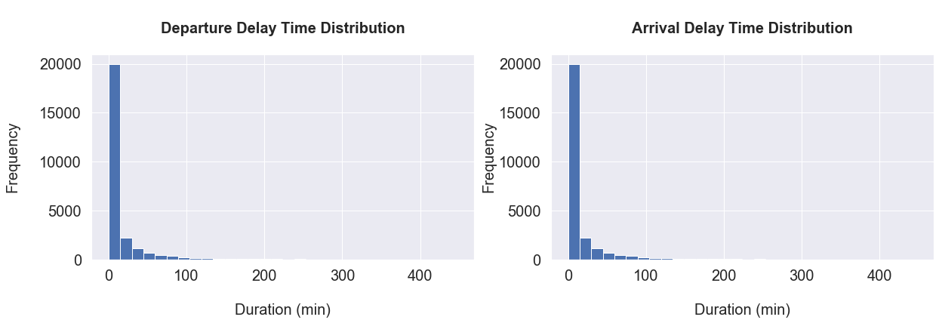
Framework
3
Data Exploration & Analysis
Inferential Statistics - Hypothesis Testing
H0: The Delay incurred at the Arrival is a result of the Delay incurred at the Departure (Difference is Zero)
In other words, I want to determine whether the mean difference between Departure Delay and Arrival Delay is zero, in order to pinpoint the main source of flight delays

Slide 21
Framework
3
Data Exploration & Analysis
Inferential Statistics - Hypothesis Testing
Given that the two features, Departure Delay and Arrival Delay, do not follow a Gaussian Distribution, I had to go for non-parametric statistical significance tests:
Wilcoxon Signed-Rank Test
Non-parametric version of the paired student t-test
Assumes samples are dependent
P-value= 0.0008 -> Reject Null Hypothesis -> Distribution are not equal
Mann-Whitney U Test
Determines whether 2 independent samples were drawn from a population with the same distribution
Check whether it is equally likely that any randomly selected observation from one sample will be greater or less than a sample in the other distribution
P-value = 0.037 -> Reject Null Hypothesis -> Distribution are not equal

Slide 22
Framework
4
Feature Engineering
Feature Scaling for the numerical columns:
Age
Flight Distance
Departure Delay
Arrival Delay
Creating 2 sub-data frames:
Numcla: Numerical Based Classification Model
Catcla: Categorical Based Classification Model
Assumptions Check :
Numcla: Multi-Collinearity check for Regression Model
Drop features with Variance Inflation Factor (VIF) > 10
Dropped List:
Class Business Arrival Delay
Inflight Entertainment Baggage Handling
Inflight Service Cleanliness
Seat comfort Online Boarding
Ease of Online Booking
Notes:
Moving to step 4 of the Framework, I start the Feature Engineering of the Dataset by Feature Scaling the numerical columns…

Slide 23
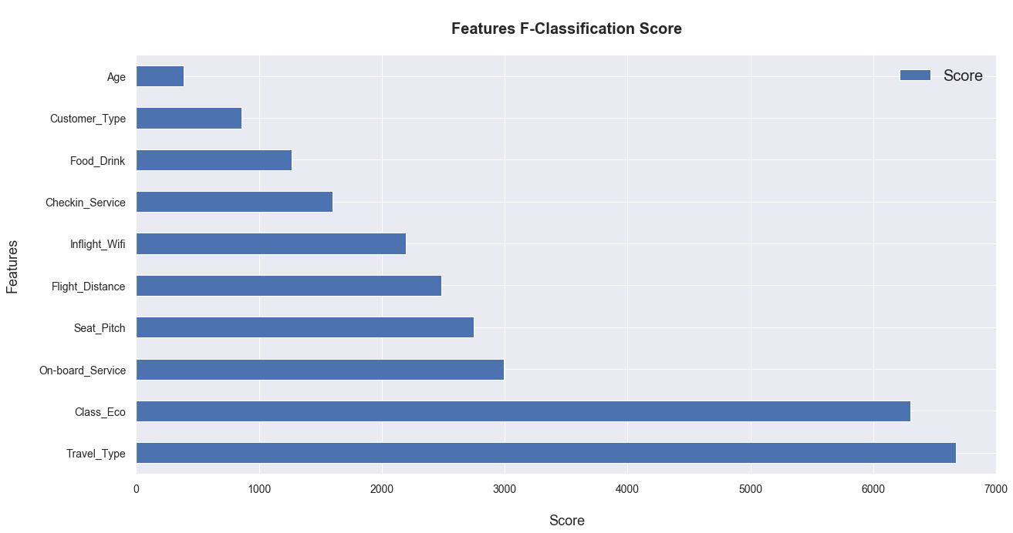
Framework
4
Feature Engineering
Feature Selection using KBest: Reduce Over-fitting, Improve Accuracy, and Reduce training time (Selecting Top 7 Features)
Filter-Based Feature Selection Methods
F- Classification and Chi-2
Notes:
Both filter methods are univariate filter methods that aim at ranking the importance of the features
They are typically used whenever you have a categorical target variable
F-Classification:
Measures the variance between features
Now, If there are equal variances between features, it means feature has no impact on response and can be dropped

Slide 24
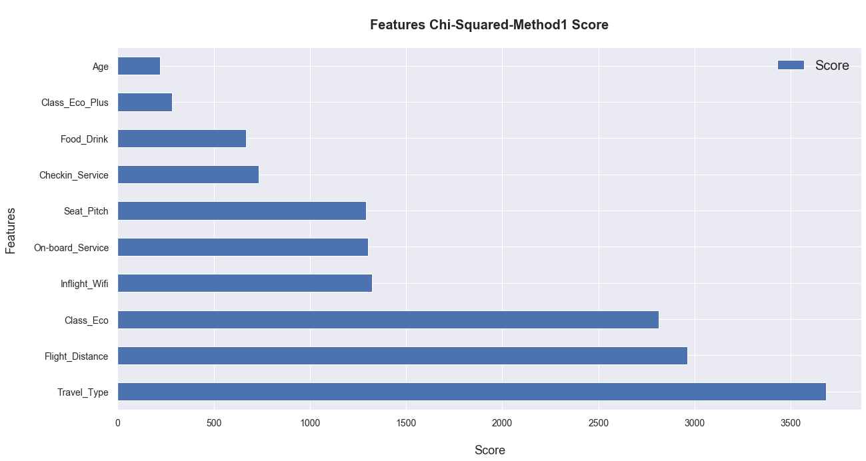
Framework
4
Feature Engineering
Chi-2:
2 models: 1: Dataset w/ Continuous Variable turned into Ordinal Categorical 2: Baseline Dataset with Numerical Features
Notes:
Chi-Squared tests for independence between categorical variables, where features that are independent of the target variable are dropped out
In the case of dependence between continuous and categorical Variable (in our case), I created 2 models, with the first having the continuous variable turned into ordinal categorical and the second kept as a baseline model for comparison of output

Slide 25
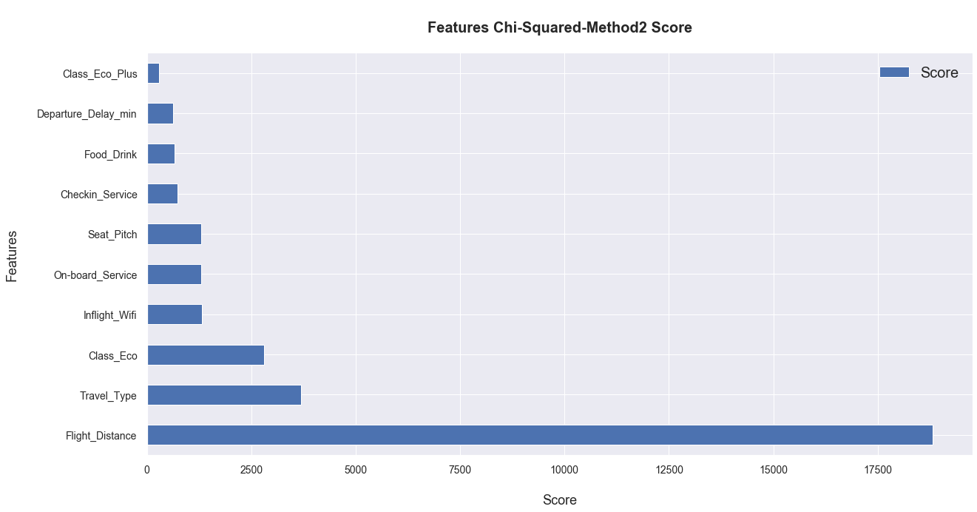
Framework
4
Feature Engineering

Slide 26
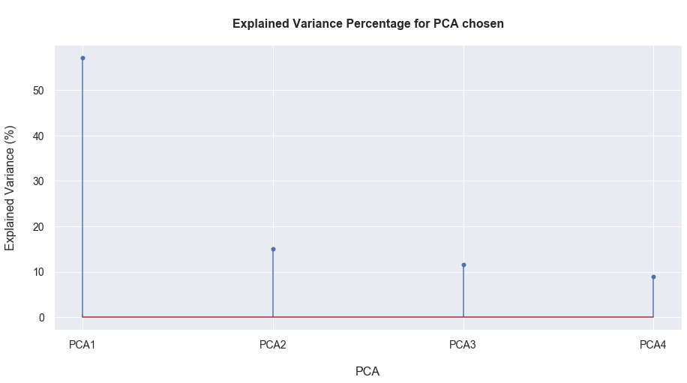
Framework
4
Feature Engineering
Principal Component Analysis (PCA): Dimensionality Reduction for the dropped features, in order to cluster them later on

Slide 27
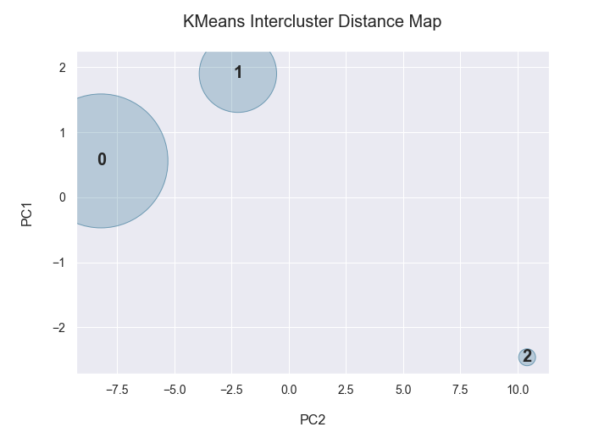
Framework
4
Feature Engineering
Kmeans Clustering
Silhouette= 0.45 and Davies-Bouldin: 0.92

Slide 28
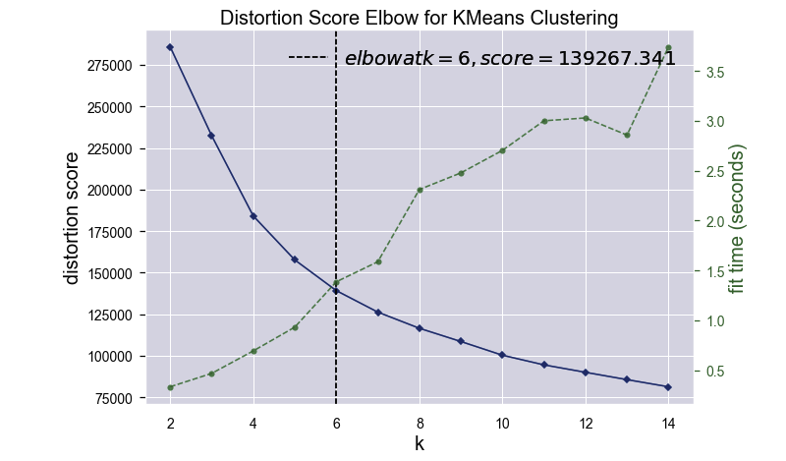
Framework
4
Feature Engineering

Slide 29
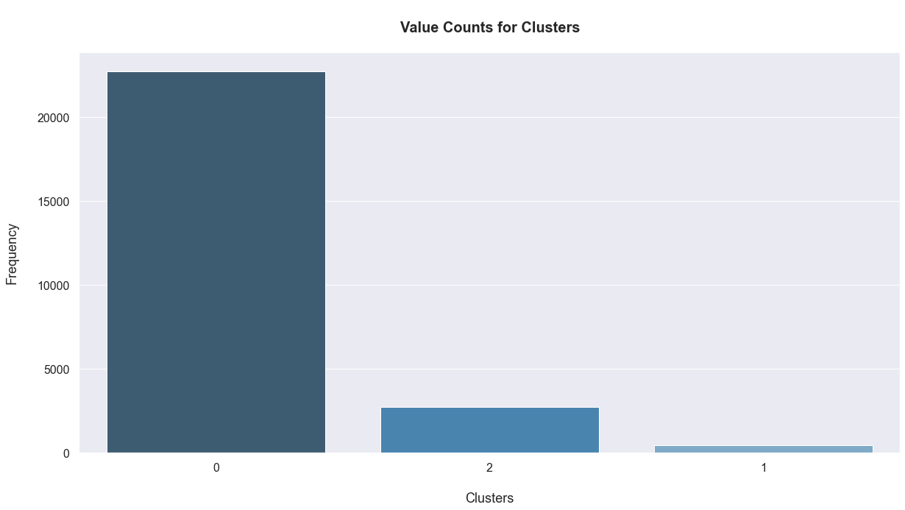
Framework
4
Feature Engineering

Slide 30
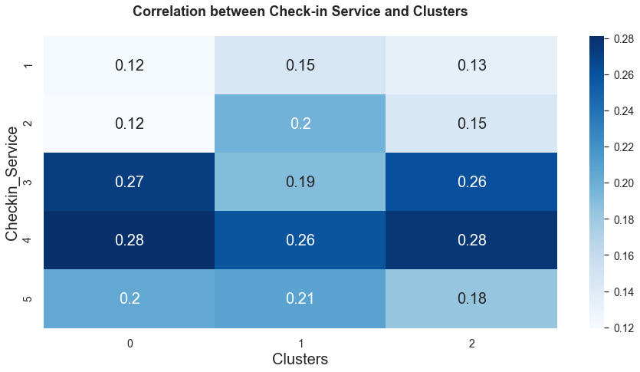
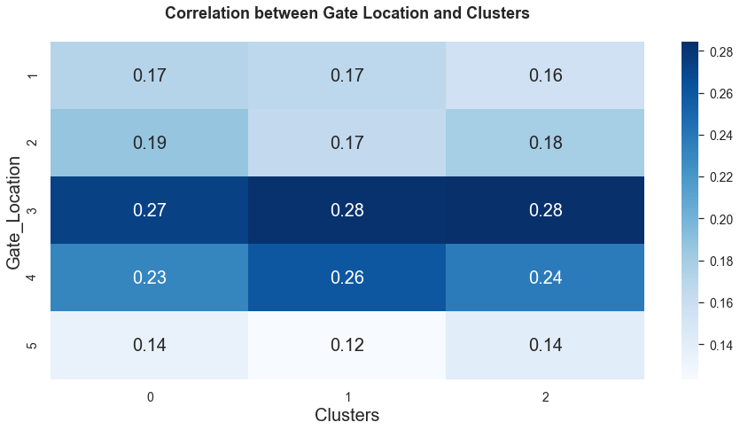
Framework
4
Feature Engineering
Comparing Correlation between Cluster and 2 selected Features (Check-in Service and Gate Location)

Slide 31
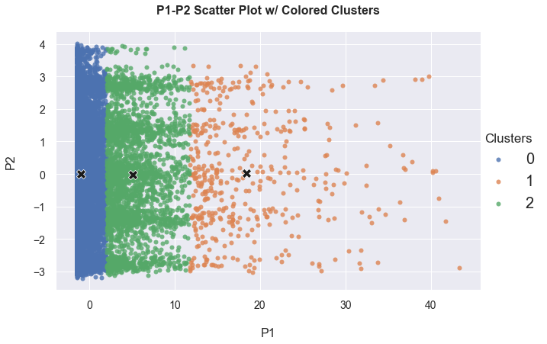
Framework
4
Feature Engineering

Slide 32
Framework
5
Machine Learning Modeling and Evaluation
Regression Predictive Modeling:
Logistic Regression
KNN
Classification Predictive Modeling:
Random Forest
XGBoost
Cross Validation: Ensure that our model is well trained with data without any over-fitting and under-fitting
Hyper-Parameter Tuning: To find the right/optimal hyper-parameters for the best model

Slide 33
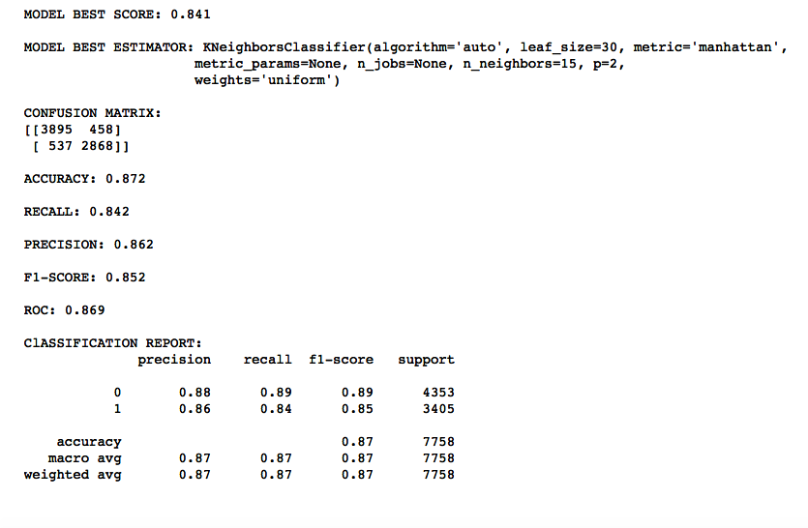
Framework
5
Machine Learning Modeling and Evaluation
KNN

Slide 34
Framework
5
Machine Learning Modeling and Evaluation
Logistic Regression
Logistic Regression | Optimal Threshold | Accuracy | Precision | Recall | F1-Score | Roc
 | 0.606 | 0.819 | 0.818 | 0.756 | 0.786 | 0.812

Slide 35
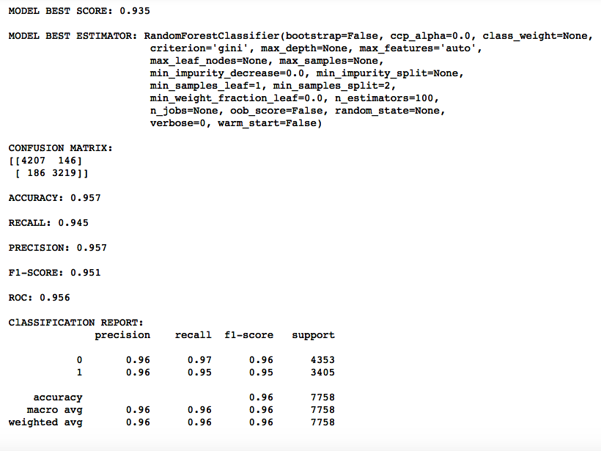
Framework
5
Machine Learning Modeling and Evaluation
Random Forest

Slide 36
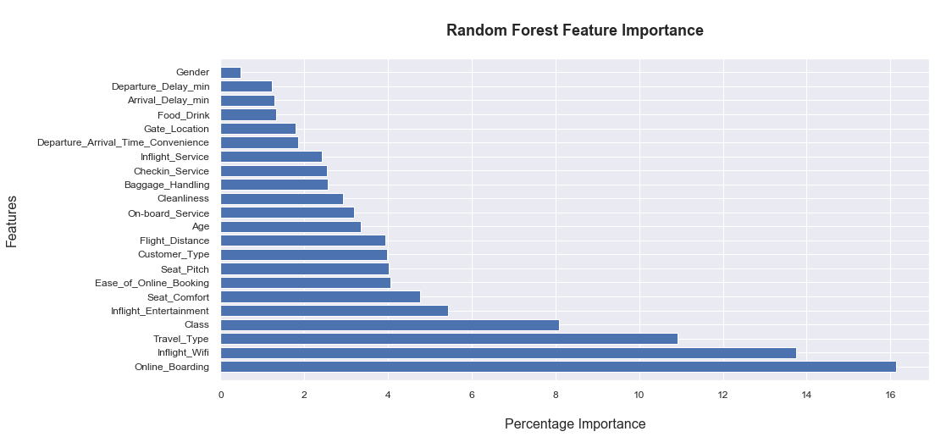
Framework
5
Machine Learning Modeling and Evaluation
Random Forest

Slide 37
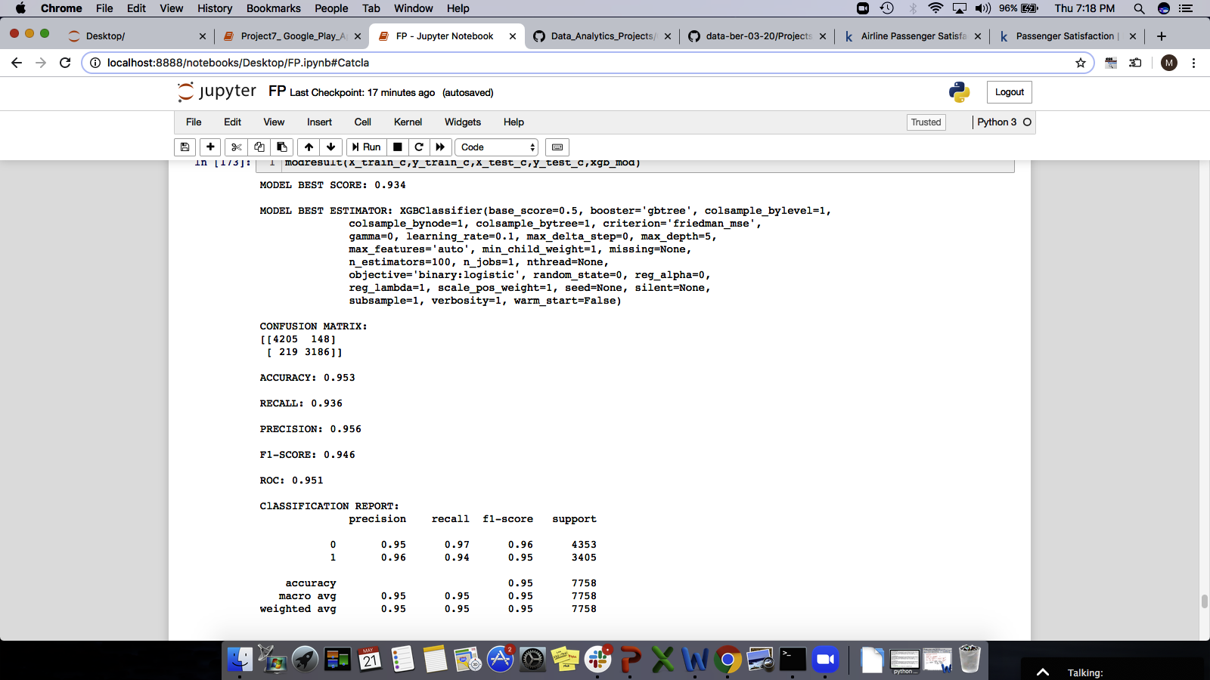
Framework
5
Machine Learning Modeling and Evaluation
XGBoost

Slide 38
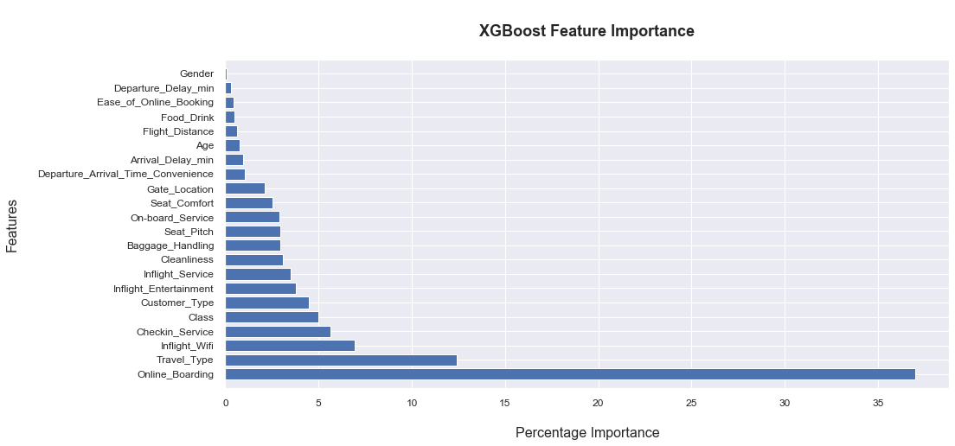
Framework
5
Machine Learning Modeling and Evaluation
XGBoost

Slide 39
Framework
5
Machine Learning Modeling and Evaluation
Accumulated Models Scores
Model | Accuracy | AUC | Recall | Precision | F1
KNN | 0.871 | 0.869 | 0.849 | 0.856 | 0.852
Logistic Regression | 0.82 | 0.813 | 0.76 | 0.816 | 0.787
Random Forest | 0.955 | 0.953 | 0.939 | 0.958 | 0.948
XGBoost | 0.953 | 0.951 | 0.936 | 0.956 | 0.946

Slide 40
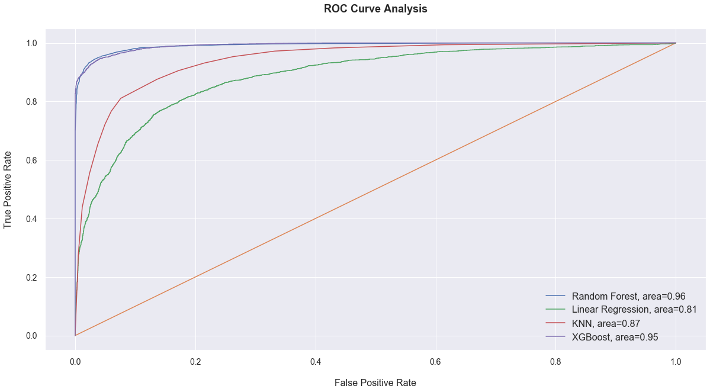
Framework
5
Machine Learning Modeling and Evaluation
Accumulated ROC Curve:

Slide 41
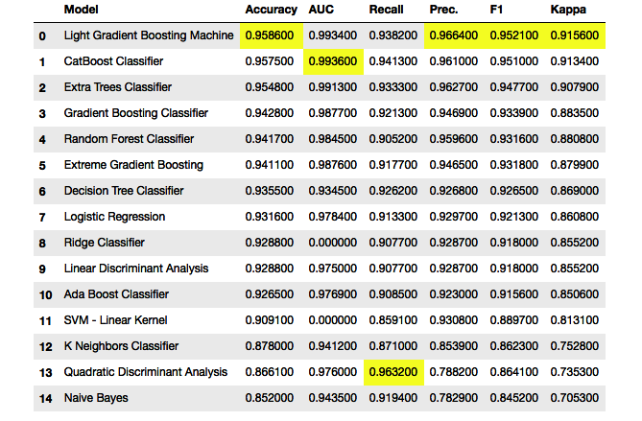
Framework
5
Machine Learning Modeling and Evaluation
PYCARET – Verification Model

Slide 42
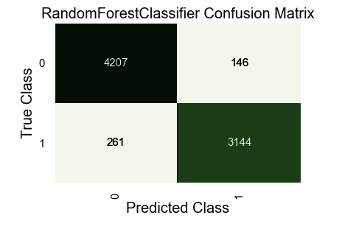
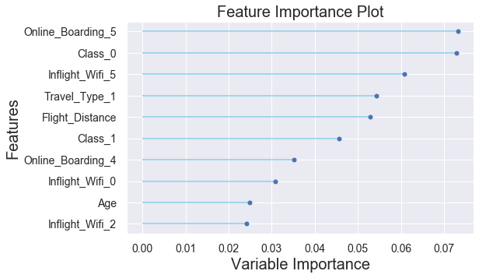
Framework
5
Machine Learning Modeling and Evaluation
PYCARET – Verification Model
Random Forest Model Plots

Slide 43
Framework
5
Machine Learning Modeling and Evaluation
Comparing Optimal Model in Sci-kit Learn with model output in PYCARET
RF-Scikit-Learn | PN | PP
TN | 4212 | 141
TP | 208 | 3197
RF-Pycaret | PN | PP
TN | 4207 | 146
TP | 261 | 3144

Slide 44
Framework
5
Machine Learning Modeling and Evaluation
Comparing Optimal Model in Sci-kit Learn with model output in PYCARET
RF-Scikit-Learn Feature Importance | RF-Pycaret Feature Importance
Online Boarding | Online Boarding _5
Inflight Wi-Fi | Class_0
Class | Inflight_Wi-Fi_5
Travel Type | Travel Type_1
Inflight Entertainment | Flight Distance
Ease of Online Booking | Class_1
Seat Comfort | Online Boarding_4
Customer Type | Inflight Wi-Fi_0
Seat Pitch | Age
Flight Distance | Inflight_Wi-Fi 2

Slide 45
Key Results
Conclusion
Random Forest Classification gave the most accurate predications for Churn Rates
Key Features that must be taken into consideration in any future revamp to enhance airline customer base (in order of importance):
Online Boarding
Inflight Wi-Fi
Class Type
Travel Type
Inflight Entertainment
Easy Online Booking
Seat Comfort
Customer Type
Seat Pitch
Flight Distance

Slide 46
Special Thanks
Eldias “The Mauritian”
“The King” Singh
Mano “Le Tough”

